Slide 1
FINANCE FIGURES
May's giving totalled £ £3,616
-thanks for your giving!
Church is running at £1,124 under budget for the year.
Church Thanksgiving fund raised £1,386 - thanks for your support.

Slide 2
THE CHURCH ON FIRE (3) Spirit-filled preaching Acts 2:37-47
19th June 2022

Slide 3
Last chance to
get involved!

Slide 4
CALL TO WORSHIP
`Sing and make music in your hearts to the Lord, always giving thanks to God the Father for everything, in the name of our Lord Jesus Christ’ (Ephesians 5:19b-20).

Slide 5
SONGS
I am a new creation
This is my prayer in the desert
An army of ordinary people
Notes:
Praise the lord, yellow

Slide 6
I am a new creation,
No more in condemnation,
Here in the grace of God I stand.
Notes:
Praise the lord, yellow

Slide 7
My heart is
over-flowing,
My love just keeps
on growing,
Here in the grace of God I stand.

Slide 8
And I will praise
You, Lord,
Yes I will praise
You, Lord,
And I will sing of all that You have done.

Slide 9
A joy that knows
no limit,
A lightness in my
spirit -
Here in the grace of God I stand.
Dave Bilbrough © 1983 Dave Bilbrough Songs/Thankyou Music
CCL Licence No. 839

Slide 10
This is my prayer
in the desert
When all that's within me feels dry
This is my prayer in my hunger and need
My God is the God
who provides

Slide 11
This is my prayer
in the fire
In weakness or trial
or pain
There is a faith proved
Of more worth than gold
So refine me Lord through the flame

Slide 12
I will bring praise
I will bring praise
No weapon formed against me shall remain
I will rejoice
I will declare
God is my victory
and He is here

Slide 13
This is my prayer
in the battle
When triumph is still
on its way
I am a conqueror and co-heir with Christ
So firm on His
promise I'll stand

Slide 14
I will bring praise
I will bring praise
No weapon formed against me shall remain
I will rejoice
I will declare
God is my victory
and He is here

Slide 15
All of my life
In every season
You are still God
I have a reason to sing
I have a reason
to worship
(x4)

Slide 16
I will bring praise
I will bring praise
No weapon formed against me shall remain
I will rejoice
I will declare
God is my victory
and He is here

Slide 17
This is my prayer
in the harvest
When favour and providence flow
I know I'm filled to be emptied again
The seed I've received
I will sow
Brooke Fraser ©Hillsong Publishing 2008
CCL Licence Number: 839

Slide 18
An army of
ordinary people
A kingdom where love is the key,
A city, a light to
the nations,
Heirs to the promise are we.
Notes:
2nd coming, blue

Slide 19
A people whose life
is in Jesus,
A nation together
we stand.
Only through grace
are we worthy,
Inheritors of the land.

Slide 20
A new day is dawning,
A new age to come,
When the children
of promise
Shall flow together
as one.

Slide 21
A truth long neglected,
But the time has
now come
When the children
of promise
Shall flow together
as one.

Slide 22
A people
without recognition,
But with Him a
destiny sealed,
Called to a
heavenly vision,
His purpose shall
be fulfilled.

Slide 23
Come, let us stand strong together,
Abandon ourselves
to the King,
His love shall be
ours forever,
This victory song
we shall sing.

Slide 24
A new day is dawning,
A new age to come,
When the children
of promise
Shall flow together
as one.

Slide 25
A truth long neglected,
But the time has
now come
When the children
of promise
Shall flow together
as one.
Dave Bilbrough. © 1983 Kingsway’s Thankyou Music.
CCL Licence Number 839

Slide 26
OPENING PRAYER
God our source and guide and goal: you have made us in your image and set us in a world full of beauty; you dwell in unapproachable light, yet you have come among us, full of grace and truth.

Slide 27
You have revealed yourself in our Saviour Jesus Christ. Help us by your Spirit to worship you in spirit and in truth; through Jesus Christ our Lord. Amen.

Slide 28
CONFESSION
The Bible tells us that all have sinned and fall short of the glory of God (Rom. 3.23). If we say we have no sin we deceive ourselves and the truth is not in us. If we confess our sins, God, who is faithful and just, will forgive us our sins (1 John 1.8-9). Let us confess our sins and seek God’s forgiveness.

Slide 29
Let us confess our sins and seek God’s forgiveness.
Almighty God, we confess before you our own sin, the sin of the Church and the sin of the world, in which we share.

Slide 30
We have not loved you with our whole being; we have not loved our neighbour as ourselves. In your mercy, forgive us when we turn to you; release us from the burdens of the past, and remake us in your image and likeness through Jesus Christ our Lord. Amen.

Slide 31
ASSURANCE OF PARDON
If anyone is in Christ, there is a new creation (2 Cor. 5.17). Through him your sins are forgiven. Amen.
Thanks be to God.

Slide 32
OFFERTORY
Almighty God, out of the fulness of your gifts we bring before you this bread and wine, our gifts and our lives. Blessed be your holy name forever, through Jesus Christ our Lord.

Slide 33
PRAYER FOR SUNDAY CLUB
Gracious God, as we have offered all we have and are, we now pray for the children and leaders of Sunday Club. Bless their time together that it may be a time of growth in faith for all; through Jesus Christ our Lord. Amen.

Slide 34
READING: Acts 2:37-47
When the people heard this, they were cut to the heart and said to Peter and the other apostles, “Brothers, what shall we do?”

Slide 35
³⁸ Peter replied, “Repent and be baptized, every one of you, in the name of Jesus Christ for the forgiveness of your sins. And you will receive the gift of the Holy Spirit. ³⁹ The promise is for you and your children and for all who are far off—for all whom the Lord our God will call.”

Slide 36
⁴⁰ With many other words he warned them; and he pleaded with them, “Save yourselves from this corrupt generation.” ⁴¹ Those who accepted his message were baptized, and about three thousand were added to their number that day.

Slide 37
⁴² They devoted themselves to the apostles’ teaching and to fellowship, to the breaking of bread and to prayer. ⁴³ Everyone was filled with awe at the many wonders and signs performed by the apostles.

Slide 38
⁴⁴ All the believers were together and had everything in common. ⁴⁵ They sold property and possessions to give to anyone who had need. ⁴⁶ Every day they continued to meet together in the temple courts.

Slide 39
They broke bread in their homes and ate together with glad and sincere hearts,⁴⁷ praising God and enjoying the favour of all the people. And the Lord added to their number daily those who were being saved.

Slide 40
This is the Word of the Lord
Thanks be to God

Slide 41
REFLECTION
THE CHURCH ON FIRE (3)
Spirit-filled living

Slide 42
PRAYERS

Slide 43
THE LORD’S PRAYER
Our Father in heaven,
Hallowed be your name.
Your kingdom come,
Your will be done on earth as in heaven
Give us today our daily bread.

Slide 44
Forgive us our sins
as we forgive those who sin against us.
Lead us not into temptation
but deliver us from evil.
For the kingdom, the power and the glory
are yours now and for ever. Amen.

Slide 45
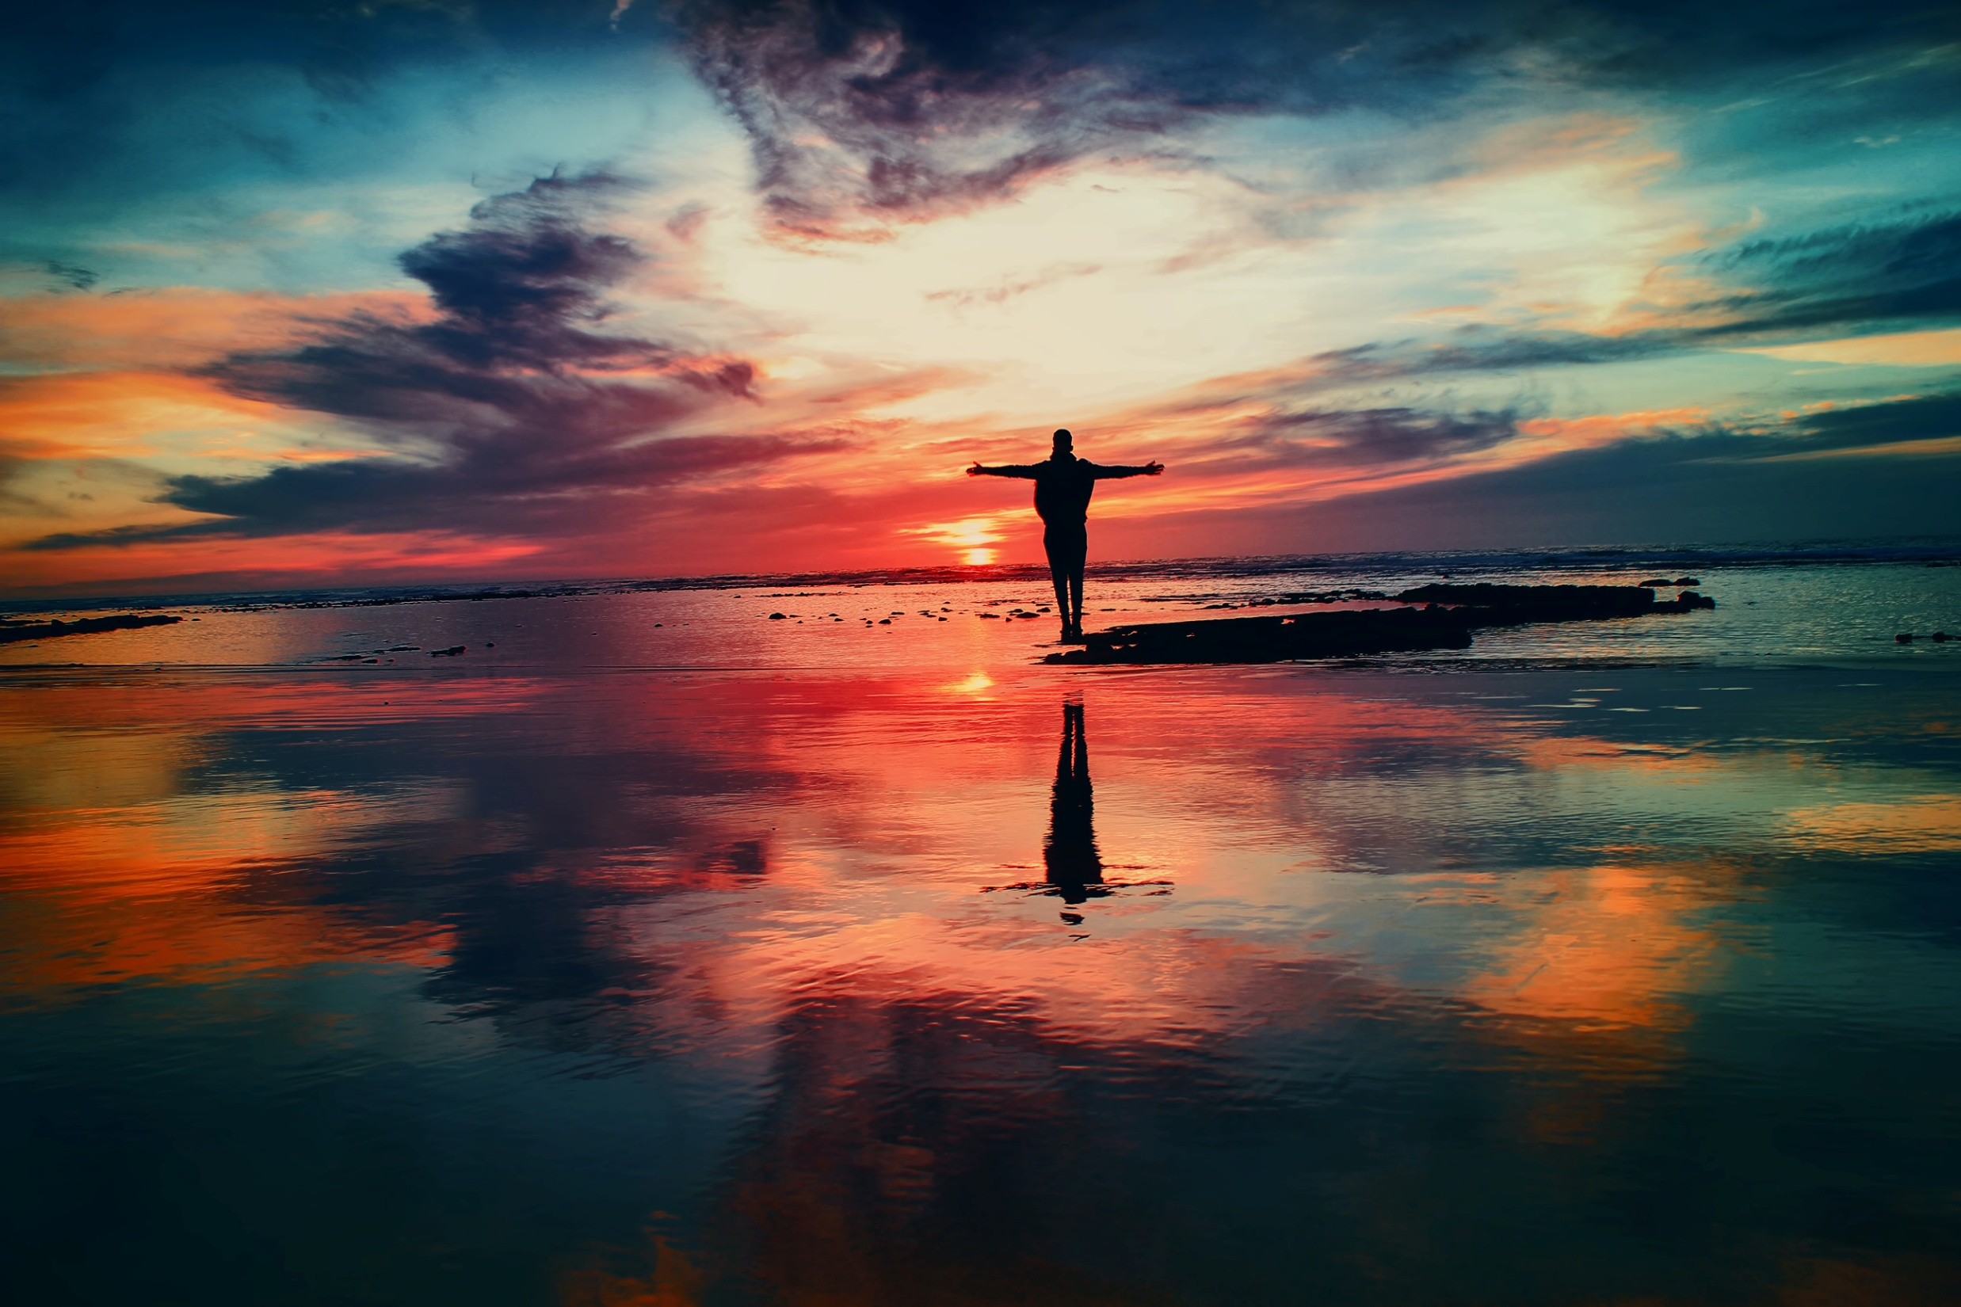
SONG
What a friend we have in Jesus

Slide 46
What a friend we have in Jesus,
All our sins and griefs to bear!
What a privilege
to carry
Everything to God
in prayer!
Notes:
Jesus 2, black

Slide 47
Oh, what peace we often forfeit,
Oh, what needless pain we bear -
All because we do
not carry
Everything to God
in prayer.

Slide 48
Have we trials and temptations,
Is there trouble anywhere?
We should never be discouraged:
Take it to the Lord
in prayer.

Slide 49
Can we find a friend
so faithful,
Who will all our sorrows share?
Jesus knows our
every weakness -
Take it to the Lord
in prayer!

Slide 50
Are we weak and heavy-laden,
Cumbered with a
load of care?
Precious Saviour still our refuge
Take it to the Lord
in prayer!

Slide 51
Do thy friends despise, forsake thee?
Take it to the Lord
in prayer;
In His arms He’ll take
and shield thee,
Thou wilt find a
solace there.
Joseph Scriven CCL Licence Number: 839

Slide 52
PEACE

Slide 53
Let the peace of Christ rule in your hearts, since as members of one body you were called to peace (Col. 3:15).
The peace of the Lord be always with you and also with you.
Let us offer one another a sign of peace.

Slide 54
HOLY COMMUNION
As we gather at this table, we remember that Jesus was born of Mary; he lived our common life on earth; he suffered and died for us; on the third day God raised him from the dead; and he is always present with us through the Holy Spirit.

Slide 55
In his presence, and in the company of all the people of God, past, present, and to come, we celebrate the Supper of the Lord. ‘Listen! I am standing at the door, knocking; if you hear my voice and open the door, I will come in to you and eat with you, and you with me.’ (Revelation 3: 20)

Slide 56
The Lord is here
His Spirit is with us
Lift up your hearts.
We lift them to the Lord.
Let us give thanks to the Lord our God.
It is right to give our thanks and praise.

Slide 57
We give thanks to you, O God, that from the earth you cause the grain to come for the making of bread and that you cause the vine to yield fruit. We praise you for Christ, the bread of life and true vine, whose body was given for us, and whose blood was poured out for us.

Slide 58
By your Holy Spirit sanctify us and these your gifts of bread and wine, that the bread which we break may be the communion of the body of Christ, and the cup which we bless may be the communion of the blood of Christ. As we share the sufferings of Christ, so give us grace to know the power of his resurrection,

Slide 59
that we may be made one and evermore abide in him, to your praise and glory; through Jesus Christ our Lord.
When Jesus had given thanks he broke the bread and said: ‘Take, eat: this is my body which is for you. Do this in remembrance of me.’

Slide 60
When Jesus had given thanks, he gave the cup to his disciples and said: ‘Drink this, all of you; for this is my blood of the new covenant, which is shed for you and for many, for the forgiveness of sins. Do this, as often as you drink it, in remembrance of me.’ Amen.

Slide 61
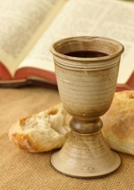
The Body of Christ broken for you.
The Blood of Christ shed for you.

Slide 62
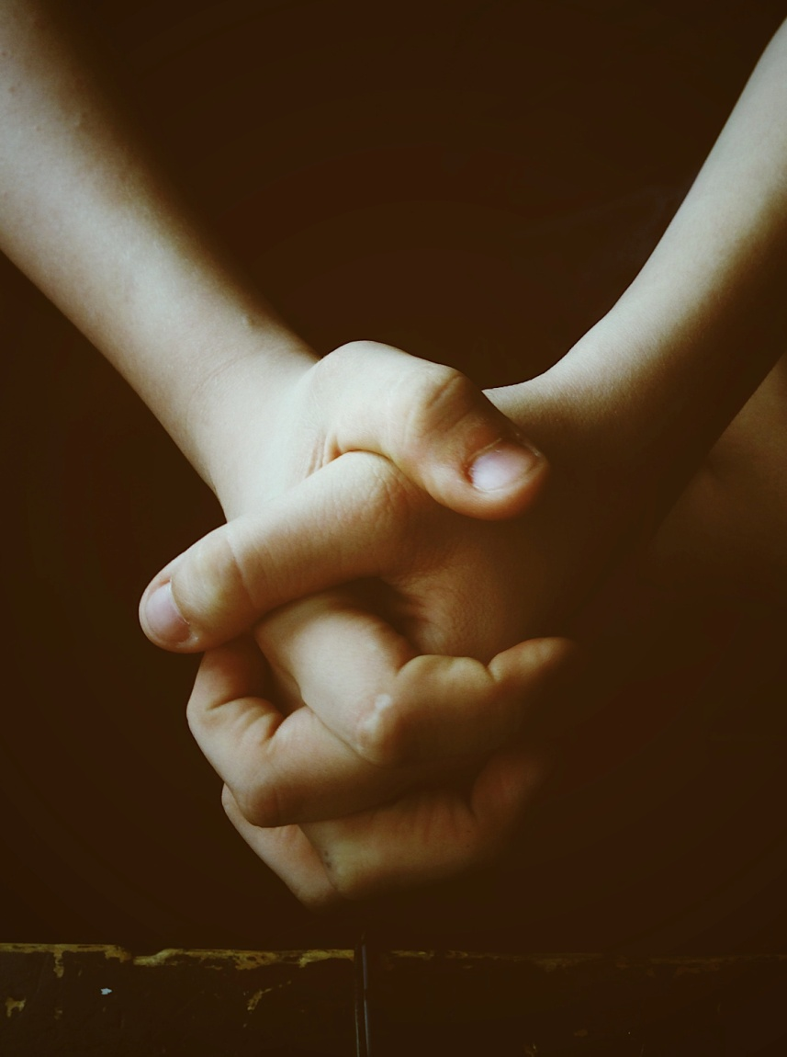
PRAYER AFTER COMMUNION

Slide 63
God of a love stronger than death, you have given us new birth into a living hope through the gift of your Son. God with us, like a mother you have fed us with yourself & strengthened us for the journey ahead. Now may the love which bids us welcome at this table gather all your children into one, in your eternal presence. Amen.

Slide 64
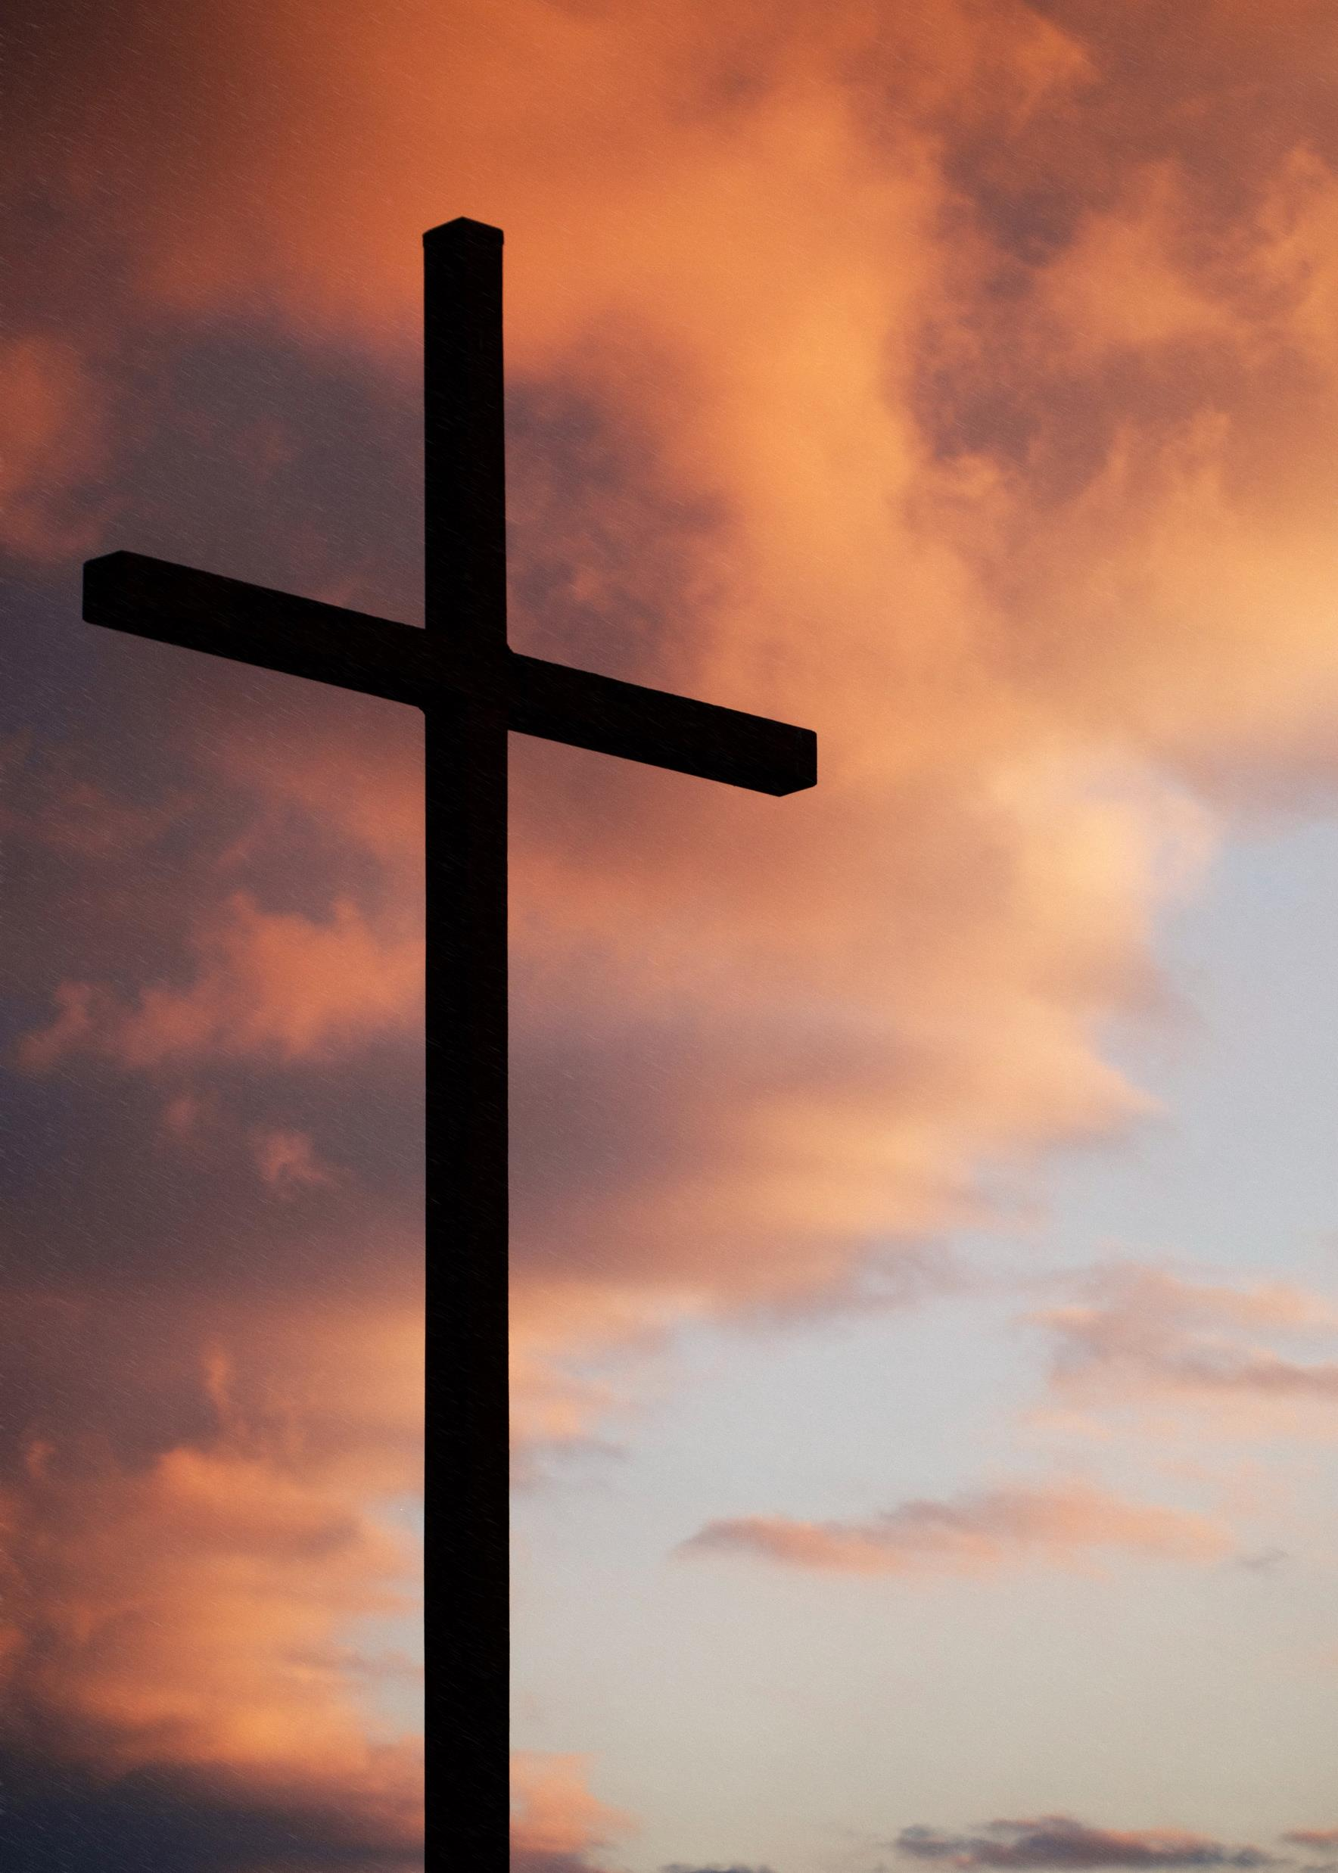
SONG
Jesus shall take the highest honour

Slide 65
Jesus shall take the highest honour,
Jesus shall take the highest praise,
Let all earth join
heaven in exalting
The name which is above all other names.

Slide 66
Let’s bow the knee in humble adoration,
For at His name every knee must bow;
Let every tongue confess He is Christ,
God’s only Son.
Sovereign Lord we give You glory now,

Slide 67
For all honour and blessing and power
Belongs to You,
belongs to You.

Slide 68
All honour and blessing and power
Belongs to You,
belongs to You,
Lord Jesus Christ, Son of the living God.
Chris Bowater ©1985 Sovereign Lifestyle Music
CCL Licence Number: 839

Slide 69
CLOSING PRAYER AND BLESSING
Most holy God, who sent your Holy Spirit upon your people to equip them for your mission in the world, fill us with your Spirit and send us in Jesus’ name into your world. Amen.

Slide 70
And the blessing of God Almighty, the Father, the Son and the Holy Spirit be with you and with all whom you love, now and for evermore. Amen.
Go in peace to love and serve the Lord
In the name of Christ. Amen.

